Slide 1
Basic TouchDesigner Workshop
AVD-Minor - HU
Raul Leal (Digital Piglet) ｜ 21. 09. 2024

Slide 2

Workshop Structure
Next Week
Intro
Draw things
Make them move
Add logic to the movement
Make them audio reactive
Make them interactive

Slide 3
This Workshop
What we will do!
What we will not do
Basic Introduction
Programming with TD
Common useful logic patterns
Assigning references
Bauhaus motion graphics
Have fun
No 3D
No Particles
No Kinect

Slide 4

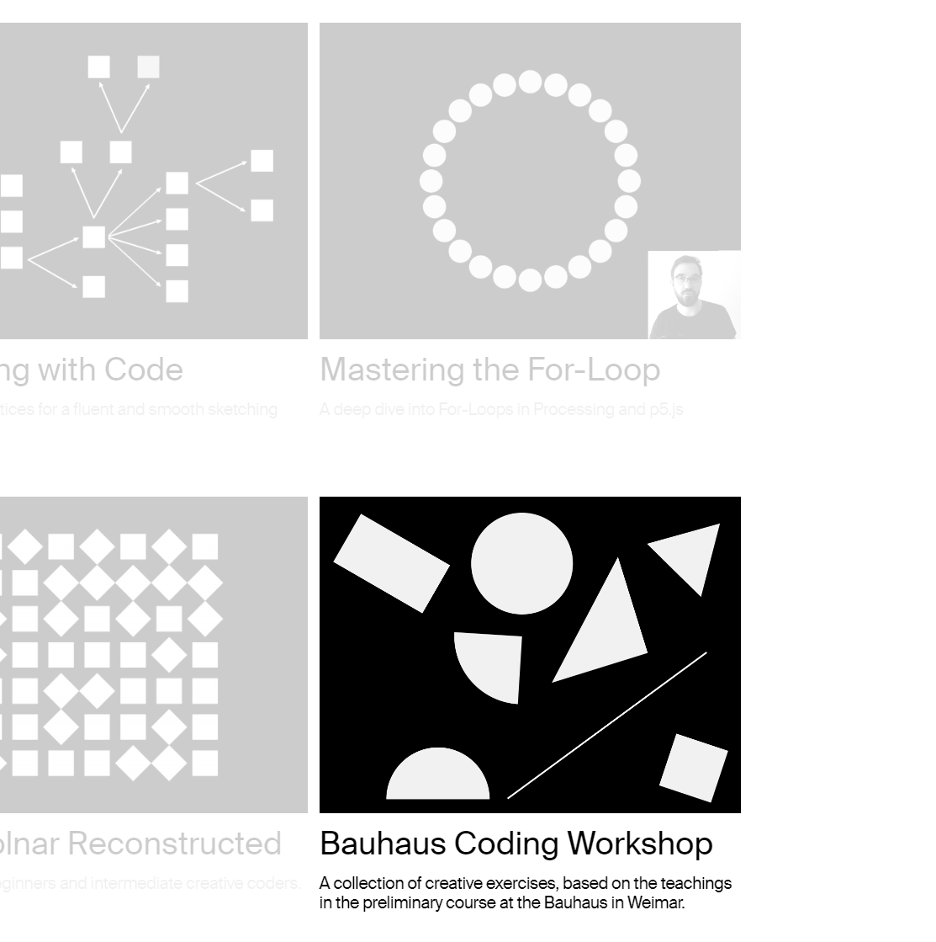
Tim Rodenbröker

Slide 5
Two main principles…
TouchDesigner is a programming language…
…It requires a “different” mindset

Slide 6
In a nutshell…
It is free!
Node-based programming language
Essentially function composition f(g(h(x)))
Very good for making data into visuals (not scientific)
Very good for interactivity
Getting sensor data and sending it back to devices
Not good at making sound – go to Ableton or Max
Good to orchestrate midis though
Good for Ableton integration

Slide 7
Let’s Begin!

Slide 8
Challenge 1
Use TochDesigner to make 4 motion graphics that...
Only use...
Only use...
they are a 2d motion graphic animation,
i.e. no 3d scenes, objects etc..

Slide 9
Challenge 2
Add some logic to your animations, make 4 videos for insta
Only use...
Only use...
they are a 2d motion graphic animation,
i.e. no 3d scenes, objects etc..

Slide 10
Challenge 3
Make your animations audio reactive, still…
Only use...
Only use...
they are a 2d motion graphic animation,
i.e. no 3d scenes, objects etc..

Slide 11
For next class…
Bring sensors and devices for interactivity
Arduino setups
Midi controllers
Game joysticks
Whatever you can connect to your computer

Slide 12
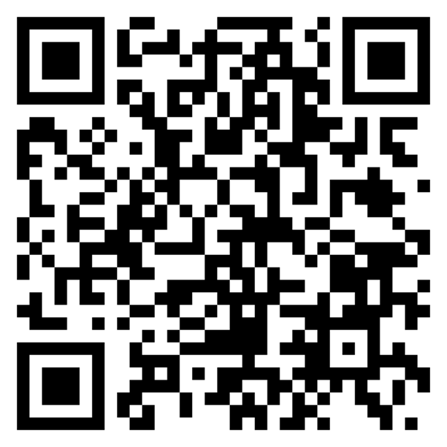
Git repository
https://github.com/Rauleal/AVD-Minor-HU/

Slide 13
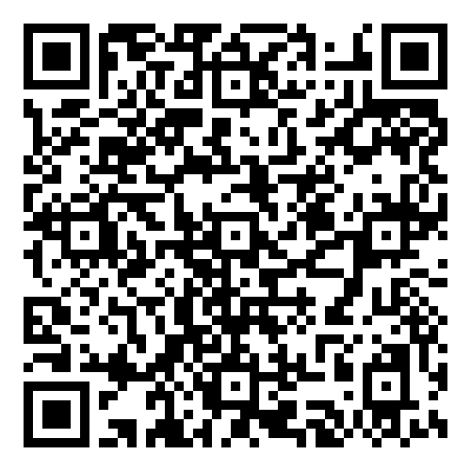
YouTube channel
https://www.youtube.com/watch?v=AMGkNHyQ4o0&list=PL3zGSOEHGdiR5x5BIg8E8yn2BQMbQ6igb

Slide 14
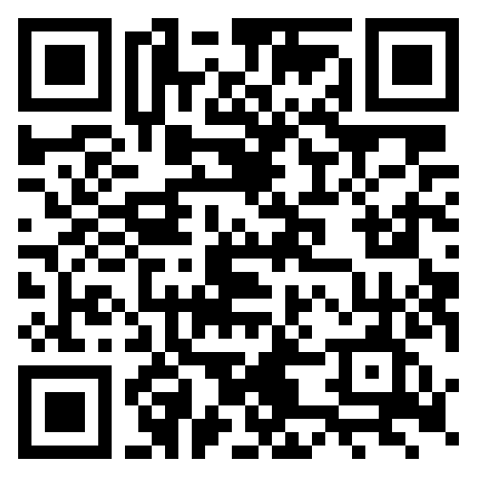
TouchDesigner Documentation
https://docs.derivative.ca/Main_Page

Slide 15
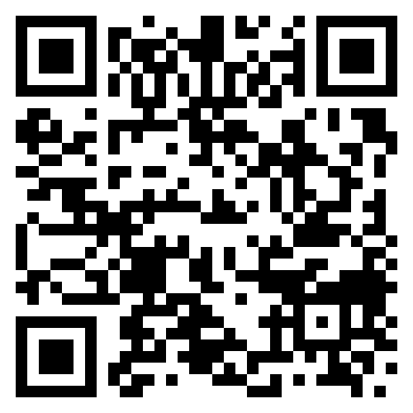
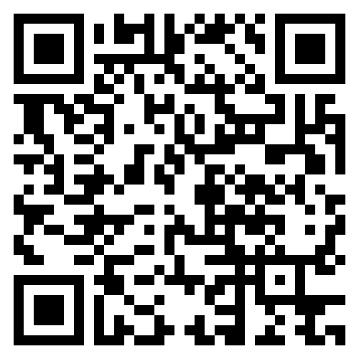
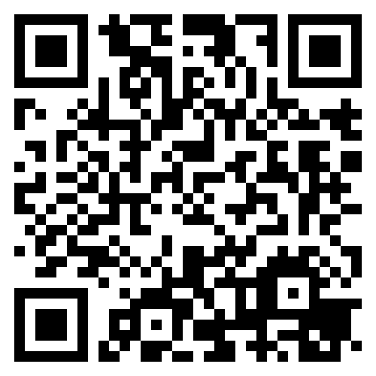
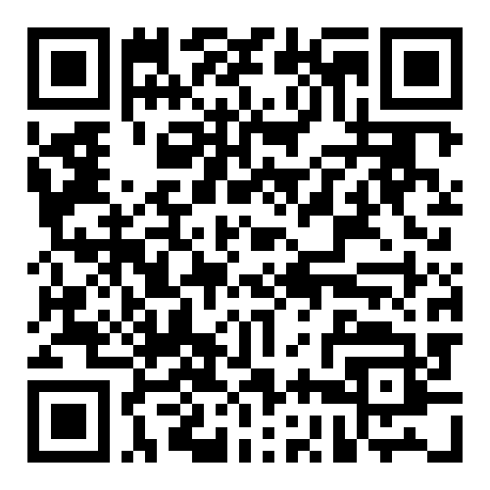
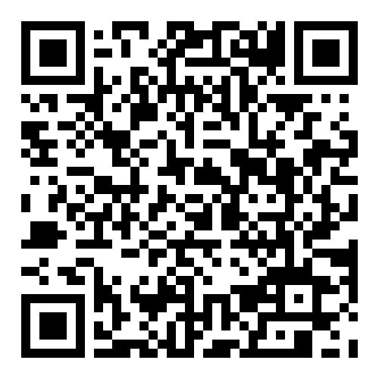
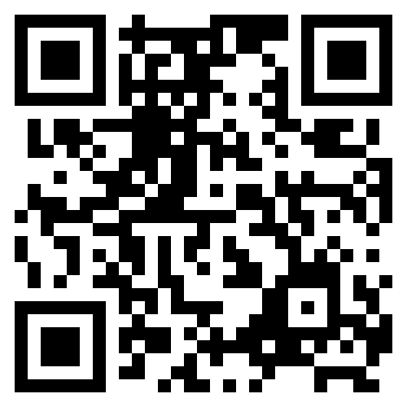
Interesting Artist/tutorials
Elekktronaut
Paketa12
Noto the talking ball
The Interactive Immersive HQ
Derivative fundamentals
Node Institute

Slide 16
For next class…
Bring sensors and devices for interactivity
Arduino setups
Midi controllers
Game joysticks
Whatever you can connect to your computer

